Slide 1
Indian Technology Innovation and Entrepreneurship Conclave (I-TEC – 3&4 January, 2020 - Reva University, Bangalore) Presentation on innovative project grant for student
Title of the innovation: Smart Shopping Companion
Name of the lead student making presentation: Harshith Kulkarni
Names of the other team members:
1) Vishal G Yadav
2) Touheed Kazmi
3) Dr. Gayathri K M – (Mentor)
Institution: Dayananda Sagar University
Please highlight the focal area of the proposal:
Health / Medical Devices
Agriculture / Sustainable Practices / Drones
IT/ Cloud Computing
Advanced Materials
Clean Water
Automation / Robotics / IOT
Educational Technologies
AI/ML
Financial Technologies
Renewable Energy / Electric Vehicles
Manufacturing / 3D Printing

Slide 2
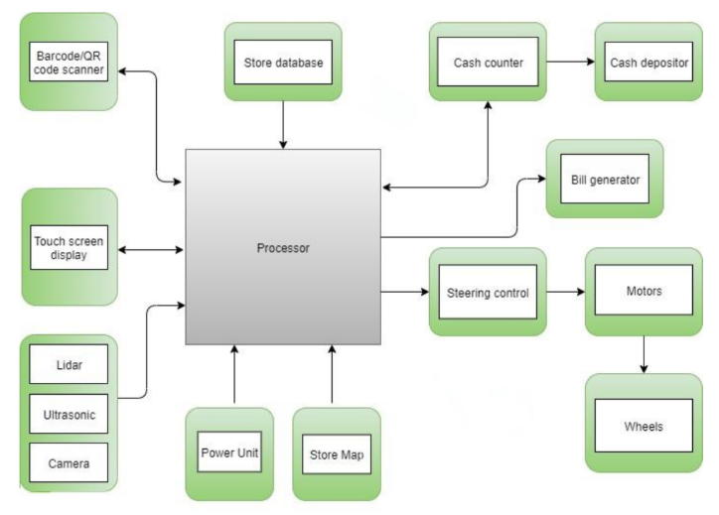
Describe the Technology behind the Innovation (you can add any figures, illustrations or mathematical expressions for illustration.
The smart shopping companion is developed using the latest technology of sensor networks and Artificial intelligence to achieve most promising results.
The smart shopping companion is equipped with a chat-bot which can be used by the users to interact with the smart shopping companion using speech or using the touch screen module.
The shopping cart also equips a virtual map of the store for which it works, which is integrated with Google AR core platform for Augmented reality based path display for the users on the screen.
Smart shopping companion also has a weighing module along with the QR-code/barcode scanner for bi-step verification of any product that is picked is billed accurately. It has three payment methods integrated with the cart comprising of credit/debit card, UPI based payments and cash using our new approach of miniaturized cash-box.
The cart is equipped with high definition cameras for facial recognition of user while he/she is using the cart for his shopping and camera for Augmented reality path finder. It also contains several ultrasonic sensors and Lidar sensors for obstacle avoidance.

Slide 3
Most innovative aspect of the proposed project
Augmented reality based path display interface for users. It is used to display path of any aisle of the mart where the requested product is located. And Artificial intelligence guided obstacle avoidance with the camera vision input along with ultrasonic and Lidar sensor network input.
Miniaturized cash-box for accepting cash payments and returning the change.
Is your institution supporting your innovation, if so please provide the details such as availability of TBI, NewGen IEDC, WTP or IIC
The prototype designing and manufacturing is done with the help of Autodesk which is a tier of Dayananda Sagar university Innovation labs.

Slide 4
Any existing products similar to your innovation, if so details
Watasale: The latest retail outlet in Kochi's Gold Souk Grande Mall, is a fully-automated, cashier-free shop, inspired by Amazon Go stores in the US.
Have you participated in any hackathons / competitions before, if so details
Our team had also got an opportunity to take part in the short-listing of the project for the Design-Night which was held in Hyderabad on 9th October,2019
website link- https://twitter.com/autodeskindia/status/1181931627808612352
Our team had participated in Itron India Hackathon, 2018 based on the topic of Smart water topic and we managed to secure first place with a cash reward of INR.50,000

Slide 5
If you receive funding, can your product or solution be made market-ready; if your answer is yes what are your plans for scaling up?
Yes
We are planning to expand our market horizons by next few months by scaling up our product manufacturing by the reusable method of modifying the trollies that are already present in the shopping complexes.
We plan to borrow the trollies from the shopping complex and modify them by integrating different hardware and installing the software necessary for the trollies to be a smart shopping companion after the contract of our Terms and Conditions is being signed by the client.
Since we are planning to use the pre-existing trollies from the shopping complexes, our idea is scalable and requires less investment to deliver our service to our clients when compared with the retail shops like Watasale in which whole building should be modified to make it smart

Slide 6
Overall Budget
(Expenses on consumables and experiments are allowed. No funding is provided for equipment purchase. Total budget must be limited to Rs. 0.5 to 1 lakh)
Budget Year 1:
Justification
Sl.No. | Particulars | Quantity in Nos. | Amount in Rs | Justification
1 | Mini computer | 1 | 12000.00 | Its main processing and controlling unit
2 | High torque DC motors (30 KG capacity) | 4 | 8000.00 | Motors that can handle heavy weight, used for mobility
3 | HD camera | 2 | 12000.00 | For Facial Recognition and Products image capture
4 | Barcode/QR-code scanner | 1 | 3000.00 | For scanning Barcode/QR-code of products
5 | Precise Ultrasonic Sensors | 4 | 1000.00 | For detecting whether user is following the smart cart or not
6 | Lidars | 4 | 15000.00 | Obstacle detection from all around the cart
7 | Wheels | 6 | 3000.00 | For mobility
 | TOTAL |  | 54000.00

Slide 7
Overall Budget
(Expenses on consumables and experiments are allowed. No funding is provided for equipment purchase. Total budget must be limited to Rs. 0.5 to 1 lakh)
Budget Year 2:
Justification
Sl.No. | Particulars | Quantity in Nos. | Amount in Rs | Justification
1 | Weighing module | 1 | 1000.00 | To keep the quantity and amount(cash) of products in sync while shopping
2 | Li-ion batteries | 2 | 5000.00 | To power up the whole system
3 | Charge slots in shopping complexes | 2 | 5000.00 | To charge the smart cart
4 | High capacity motor drivers (BTS7960-(24V/43A)) | 4 | 5000.00 | Hardware to drive the high torque DC motors
5 | Cash-box | 1 | 18000.00 | Mechanical module to accept cash and return the remaining amount
6 | Display Unit | 1 | 5000.00 | For interaction of the user with the smart cart and for displaying of path, product catalog, image of user during facial recognition.
7 | Navigation module | 1 | 2000.00 | For path following and area bound security purposes
8 | Consumables | 1 | 5000.00 | Some interconnecting components like wires , switches, buzzers etc.
 | TOTAL |  | 46000.00

